Slide 1


Slide 2

Trigonometry 1.1 Heights & Distance

Slide 3
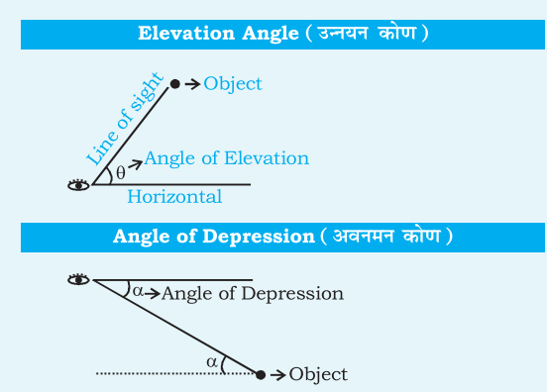
HEIGHT AND DISTANCE:

Slide 4
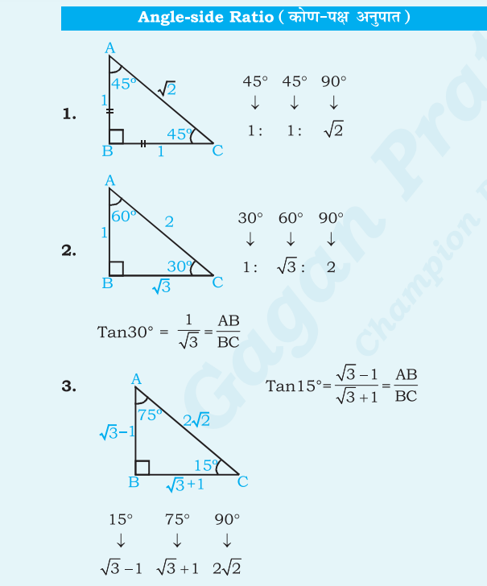
HEIGHT AND DISTANCE:

Slide 5
QUESTION 1
The length of the shadow on the ground of a tall tree of height 45 m is 15√𝟑 m. What is the angle (in degrees) of elevation of the sun?
60°
45°
35°
90°
Notes:
Ans: A) 60°

Slide 6
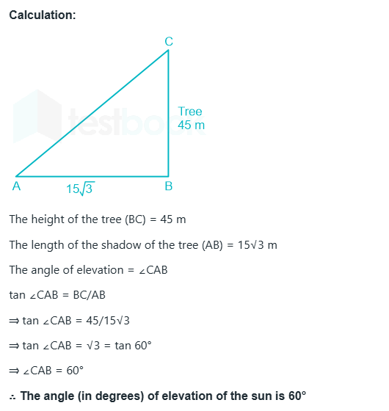

Slide 7
QUESTION 2
A girl 1.2 m tall can just see the sun over a 3.62 m tall wall which is 2.42 m away from her. The angle of elevation of the sun is:
60°
45°
30°
90°
Notes:
Ans : B) 45°

Slide 8
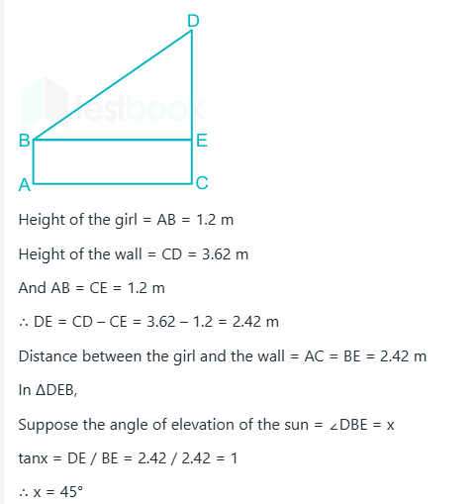

Slide 9
QUESTION 3
A person was standing on a road near a mall. He was 1215 m away from the mall and able to see the top of the mall from the road in such a way that the top of a tree, which is in between him and the mall, was exactly in line of sight with the top of the mall. The tree height is 20 m and it is 60 m away from him. How tall (in m) is the mall?
300
375
405
250
Notes:
Ans: c) 405

Slide 10
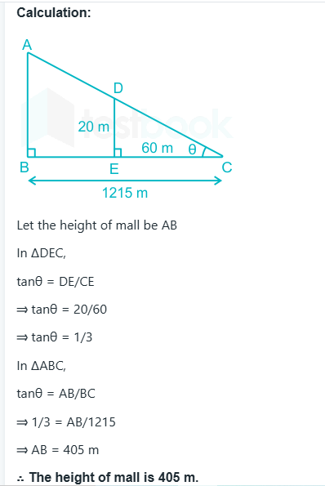

Slide 11
QUESTION 4
A ladder is bent on the wall and makes an angle θ with the horizontal ground in such a way that cos θ = 𝟓 / 13 . If the height of the top of the ladder from the wall is 18 m, find the distance (in m) of the base (foot) of the ladder from the wall.
18
7.5
13
9.5
Notes:
Ans: b) 7.5

Slide 12
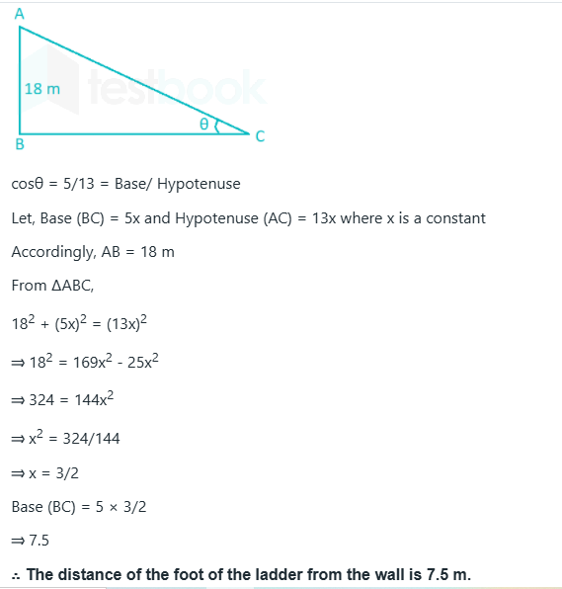

Slide 13
QUESTION 5
A ladder leaning against a wall makes an angle θ with the horizontal ground such that 𝒄𝒐𝒔𝒆𝒄𝜽 = 37 / 35 . If the foot of the ladder is 10.8 m away from the wall, what is the height of the point where the top of the ladder touches the wall?
31.5
20.8
35
28
Notes:
Ans: A) 31.5

Slide 14
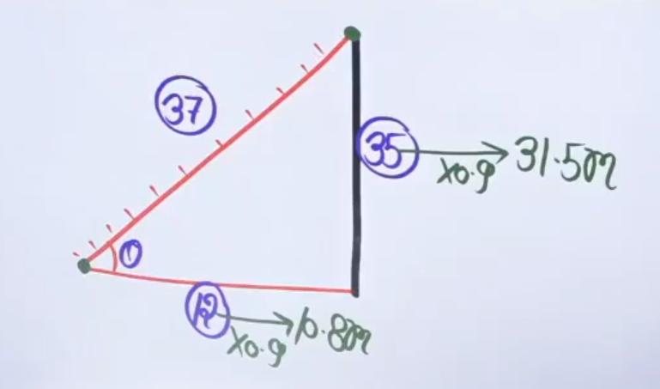
ANSWER

Slide 15
QUESTION 6
From a point P on a level ground, the angle of elevation of the top of a tower is 30°. If the tower is 𝟏𝟏𝟎√𝟑 m high, what is the distance (in m) of point P from the foot of the tower?
330
220
115
110
Notes:
Ans: A) 330

Slide 16
Question :
Find the sun’s elevation angle when the shadow of a pole of 18 m height is 6√3 m long.
Options:
30∘
60∘
45∘
None of these
Notes:
Ans: b
The angle of elevation can be calculated using the tangent function:
tan⁡θ =Height of the pole/Length of the shadow
Here, the height of the pole is 18 m and the shadow length is 6√3 m.
Substituting these values:
tan⁡θ=18/6√3 = 3/√3=√3
The angle θ whose tangent is √3 is 60∘.

Slide 17
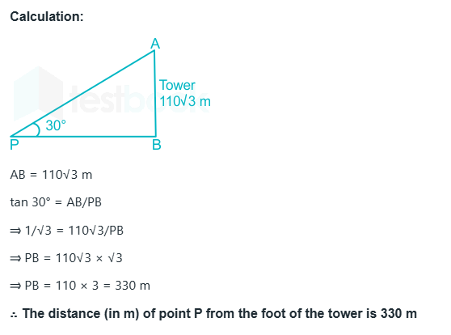

Slide 18
QUESTION 7
An person 1.8 meters tall is 30√3 metre ways from a tower. If the angle of elevation from his eye to the top of the tower is 30 degree, then what is the height (in m) of the tower?
30.5
37.8
31.8
32.5
Notes:
Ans: C) 31.8

Slide 19
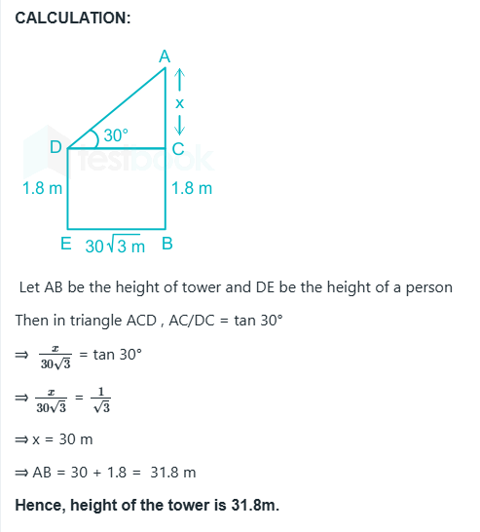

Slide 20
QUESTION 8
The tops of two poles of heights 18m and 30.5m are connected by a wire. If the wire makes an angle of 30° with the horizontal, what is the length (in m) of the wire?
20
25
28
36
Notes:
Ans: B) 25

Slide 21
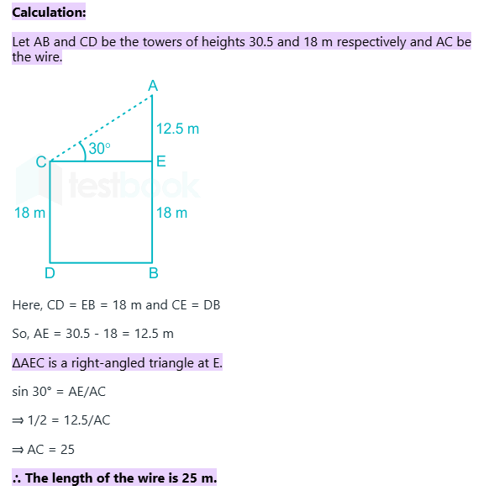

Slide 22
QUESTION 9
The distance between the tops of two building of height 38 m and 58 m respectively is 52 m. What will be the distance (in m) between two building?
46
42
44
48
Notes:
Ans: D-48

Slide 23
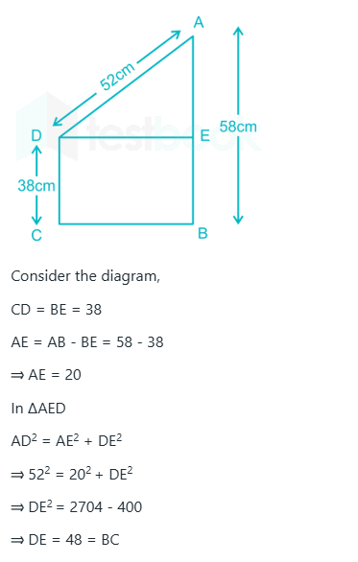

Slide 24
QUESTION 10
A pole 23 m long reaches a window which is 𝟑 √𝟓 m above the ground on one side of a street. Keeping its foot at the same point, the pole is turned to the other side of the street to reach a window 𝟒√𝟏𝟓 m high. What is the width (in m) of the street?
17
35
39
22
Notes:
Ans: C) 39

Slide 25
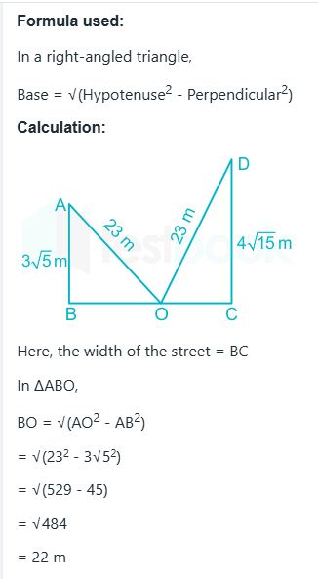
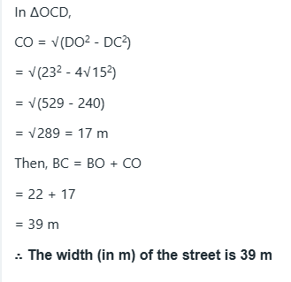

Slide 26
QUESTION 12
From a point P, the angle of elevation of a tower is such that its tangent is 3/4. On walking 560m towards the tower the tangent of the angle of elevation of the tower becomes 4/3.what is the height (in m) of the tower?
720
960
840
1000
Notes:
Ans: B) 960

Slide 27
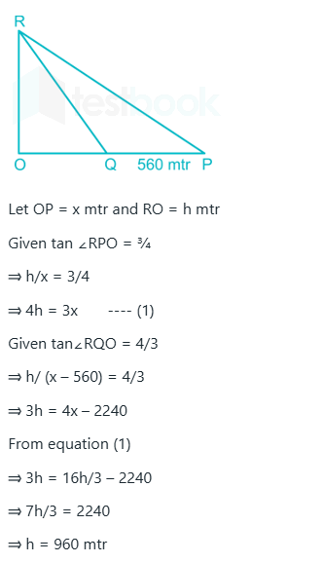

Slide 28
QUESTION 13
A ladder is placed against a wall such that it just reaches the top of the wall. The foot of the ladder is at a distance of 5 m from the wall the angle of elevation of the top of the wall from the base of the ladder is 15°. What is the length (in m) of the ladder?
5√𝟔 – 5√3
5√𝟔 – 5√2
5√𝟐 – 1
5√𝟑 + 5√2
Notes:
Ans: B) 5√𝟔 – 5√2

Slide 29
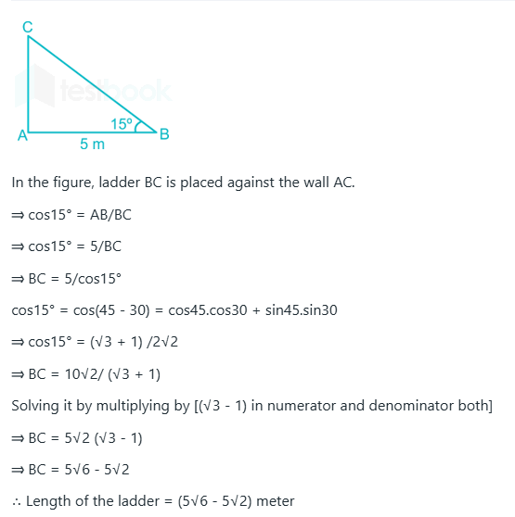

Slide 30
QUESTION 14
From the top of a tower, the angles of depression of two objects on the ground on the same side of it, are observed to be 60° and 30° respectively and the distance between the objects is 400√𝟑 m. The height (in m) of the tower is:
800√𝟑
600√3
600
800
Notes:
Ans: c) 600

Slide 31
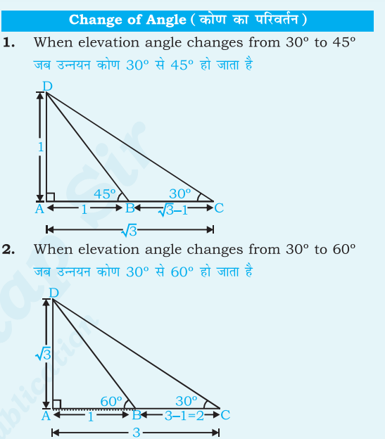
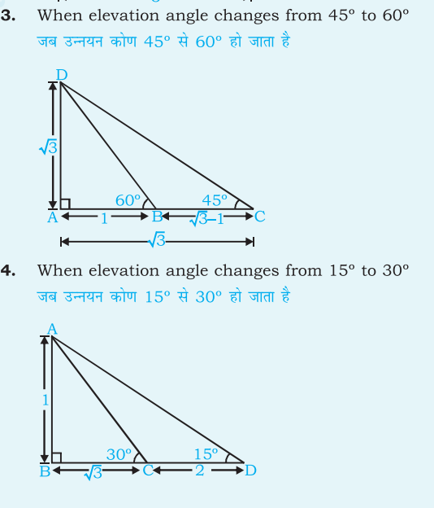
ANSWER

Slide 32
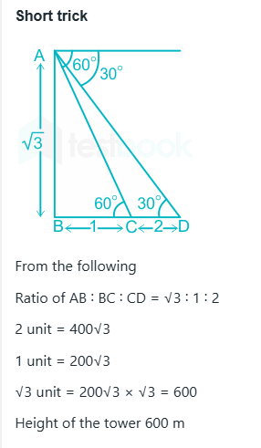

Slide 33
QUESTION 15
From a point exactly midway between the foot of two towers P and Q, the angles of elevation of their tops are 30° and 60°, respectively. The ratio of the height of P to that of Q is:
2:𝟑√3
1:𝟐√3
1:3
1:2
Notes:
Ans: c) 1:3

Slide 34
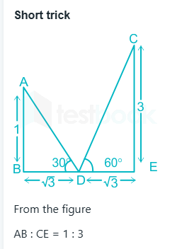

Slide 35
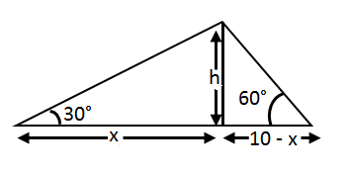
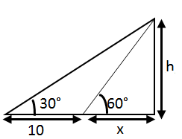
Question
Ram and Shyam are 10 km apart. They both see a hot air balloon passing in the sky making an angle of 60° and 30° respectively. What is the height at which the balloon could be flying?
case 1:
○ 5√3/2 case 2:
○ 5√3
○ 6√3/2
○ Both A & B
Notes:
ANS: d
Case 1:
tan(60°) = h / x
h= x / √3
Tan 30 deg = h/(10-x)
h = (10-x)/√3
h => 3x-x =10
X = 5
H =5√3
Case 2:
Tan 30 deg = h/x
H = x/√3
Tan 60 deg = h/(10-x)
=> h =(10 – x)√3
(10-x) √3 = x/√3
30-3x = x
4x = 30
X=15/2
H = 15/(2√3)
5√3/2
h = (10√3) / 4
h = (5√3) / 2
Hence, the answer is Both A and B

Slide 36
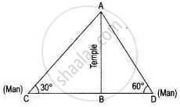
Question
Two persons are on either side of a temple, 75 m high, observe the angle of elevation of the top of the temple to be 30∘ and 60∘ respectively. The distance between the persons is
○ 156.8m
○ 173.2m
○ 180.6m
○ 189.5m
Notes:
ANS: 173.2 m
Given the height of the temple AB = 75 m.
Now in a right-angled triangle ABC,
BC/AB =cot 30
=√3
➔ BC/75 = √3
BC = 75√3 -------→ (1)
in a right-angled triangle ABD,
BD/AB =cot 60
BD/75 = 1/√3
BD = 75/√3 *√3 /√3
BD = 25√3 ------→(2)
Now the distance between the two men = CD
➔ BC + BD
➔ 75√3 + 25√3
➔ 100 √3
➔ 173.2 m

Slide 37
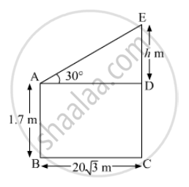
Question
One person 1.8m tall is 20√3 away from a tower. The angle of elevation from his eye to the top of the tower is 30∘. Find the height of the tower.
○ 21.8m
○ 35.6m
○ 15.9m
○ 27.8m
1.8
Notes:
ANS: 21.8 m
Triangle ADE,
tan(angle) = (opposite side) / (adjacent side)
tan(30°) = ED/AD
1/√3 = H /20√3
H= 20 m
EC = ED+DC
= H+1.8
= 21.8 m

Slide 38
Question
From a point P on a level ground, the angle of elevation of the top tower is 30∘. If the tower is 100 m high, the distance of point P from the foot of the tower is:
○ 149 m
○ 156 m
○ 173 m
○ 200 m
Notes:
ANS: 173 m
From a point 'P' on a level ground, the angle of elevation of the top of a
tower = 30
Height of the tower = 100 m
tan A = Perpendicular/Base
tan 30 = 1/√3
Let height of tower AB is 100 m.
The distance between P from foot of tower is PB.
Ιη ΔΡΑΒ
tan 30 = AB/PB
= 1/√3= 100/PB
PB = 100√3
PB = 100 * 1.732
Approx = 173m

Slide 39
THANK YOU

